Slide 1
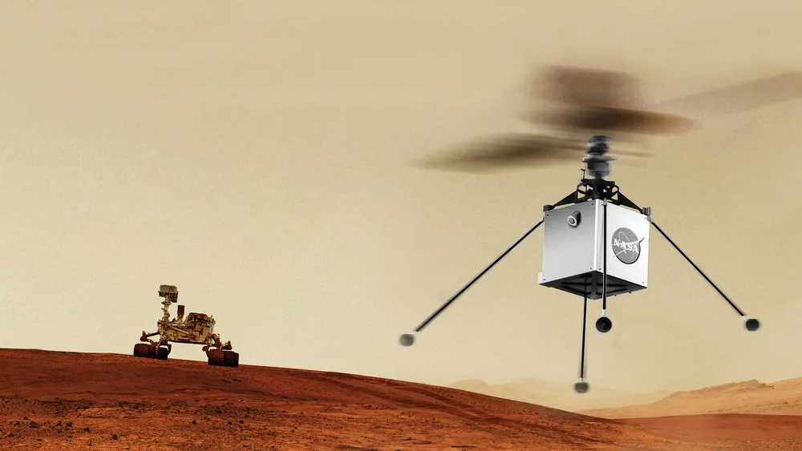
Mars Mission Emulation
Abdullah Hendy and Michael Granberry

Slide 2
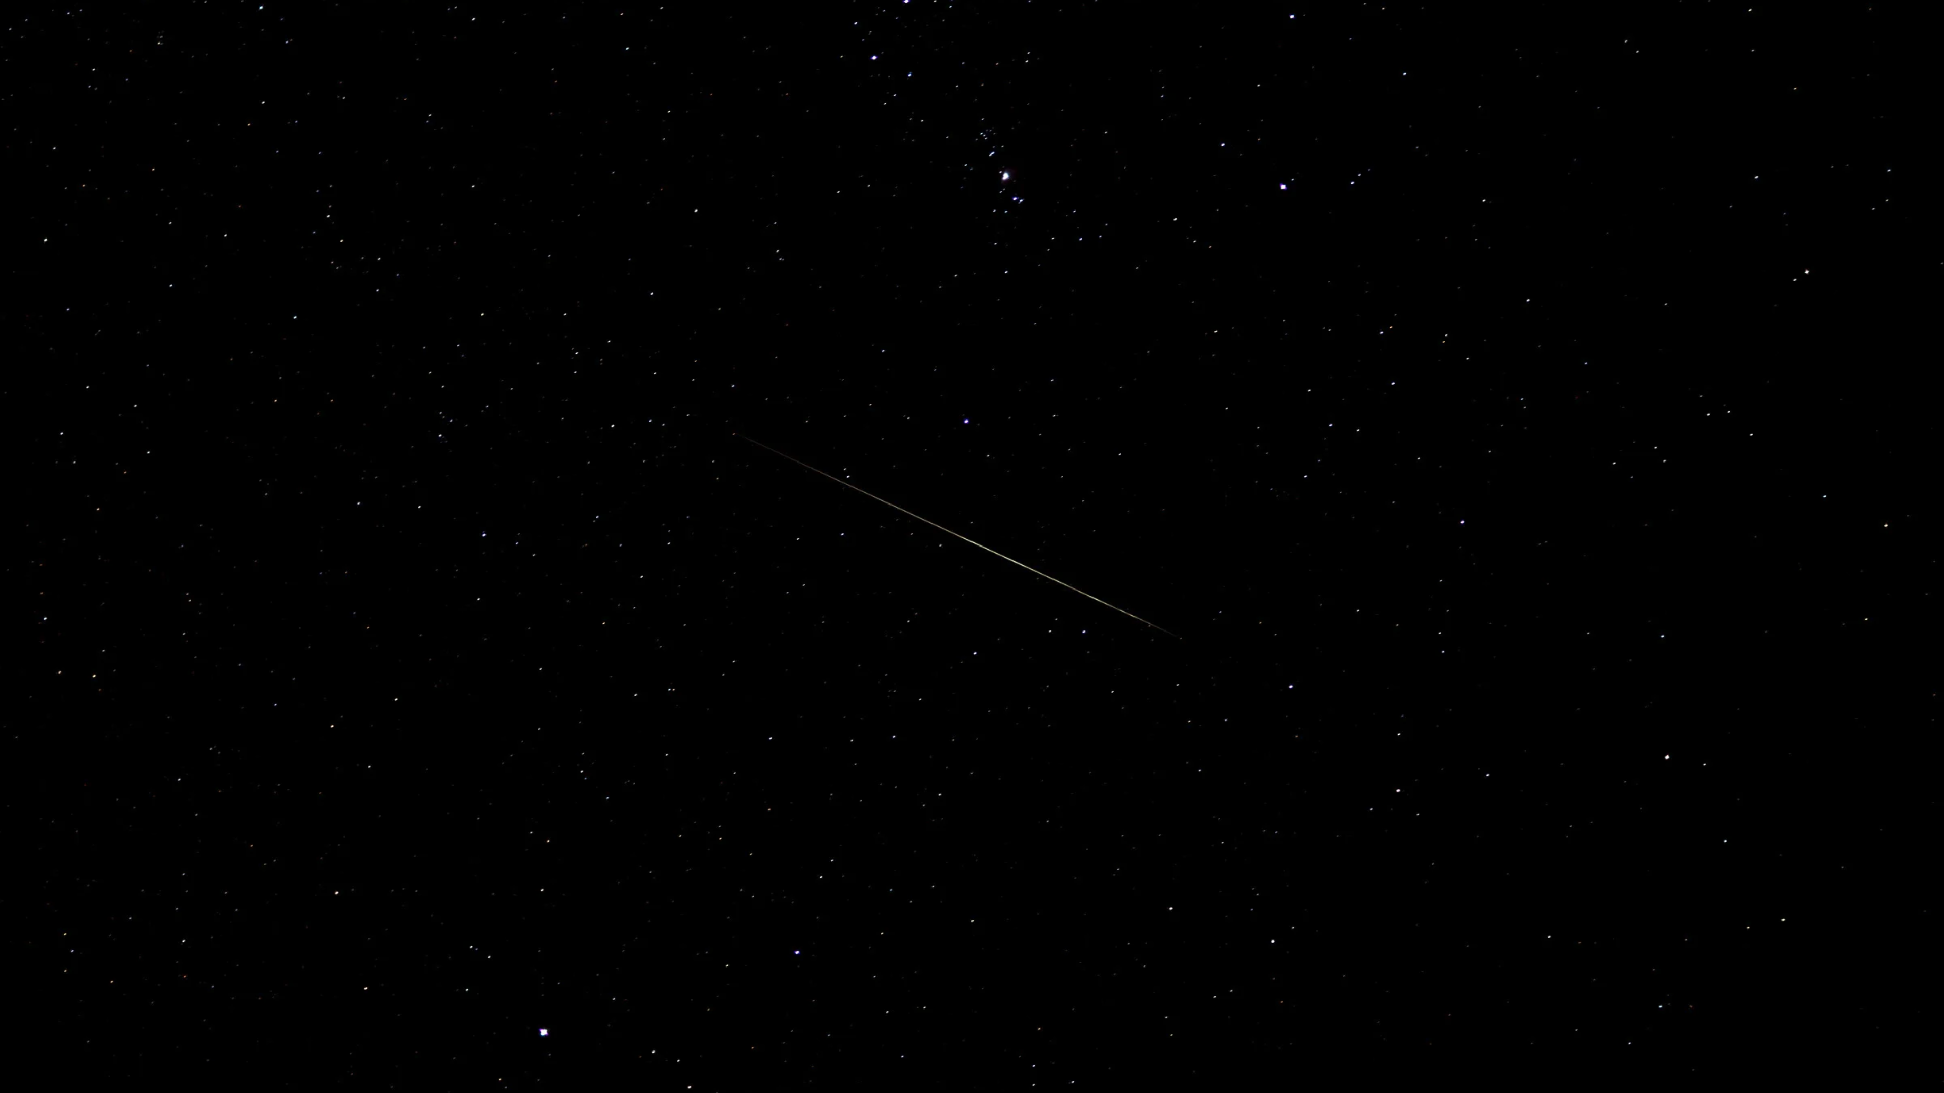
Key Points
Why Mars Mission Emulation?
An object detection drone wirelessly commanding a wheeled robot to perform tasks, mimicking the NASA's Mars Exploration Mission.
Project Goals:
Build technical framework
Build academic framework
The Drawbacks*
Mars Mission

Slide 3
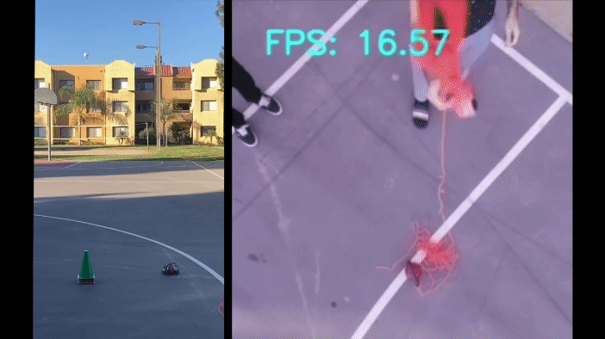
Applications Demo
Explore (Green)

Slide 4
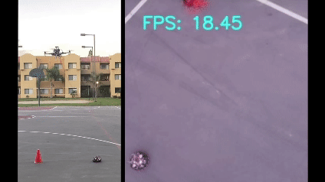
Applications Demo
Showcase (Red)

Slide 5
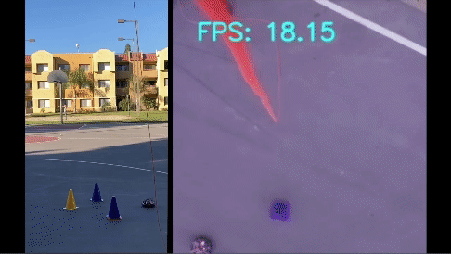
Applications Demo
Danger Avoidance (Yellow)

Slide 6
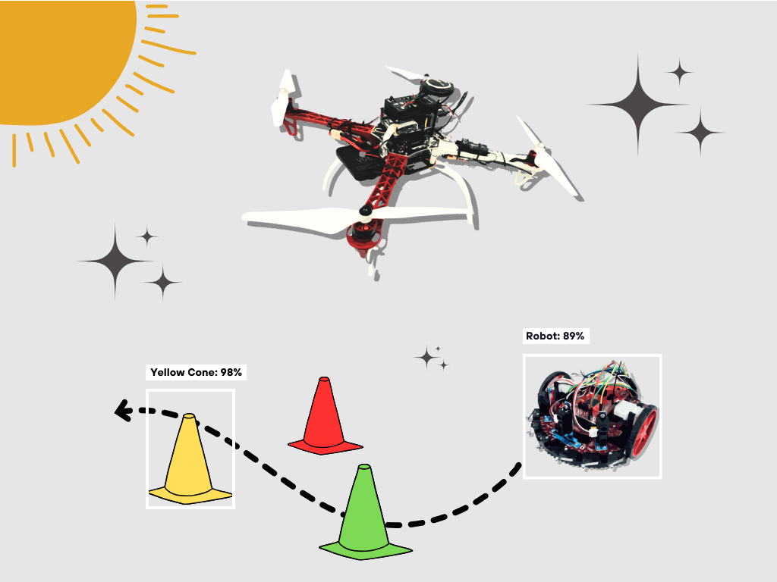
Framework Overview
Major components:
Aerial Platform
Machine learning/Computer Vision
High-level platform programming
Unmanned Aerial Vehicles Operation
3D Printing
Ground Platform
Embedded Systems
Low-level platform programming
Analog sensors
Wireless Communication
Serial Port Profile (SPP) 1.2 Bluetooth protocol
Platform Illustration

Slide 7
Framework Overview
System Block Diagram

Slide 8
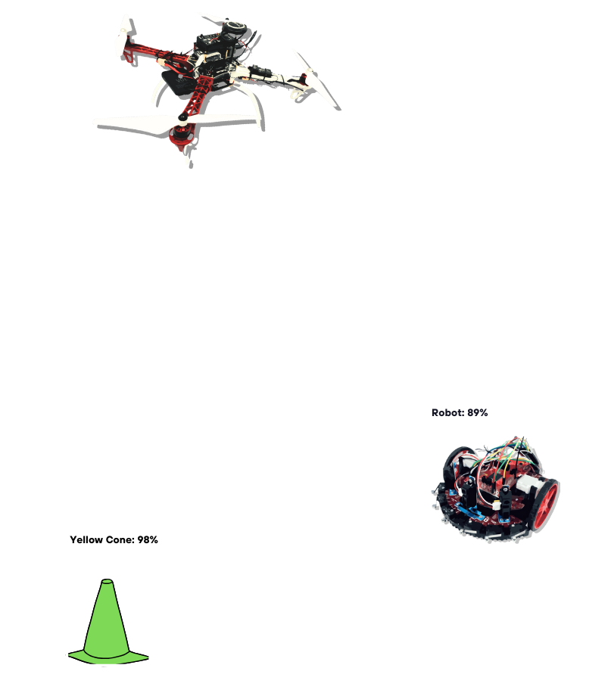
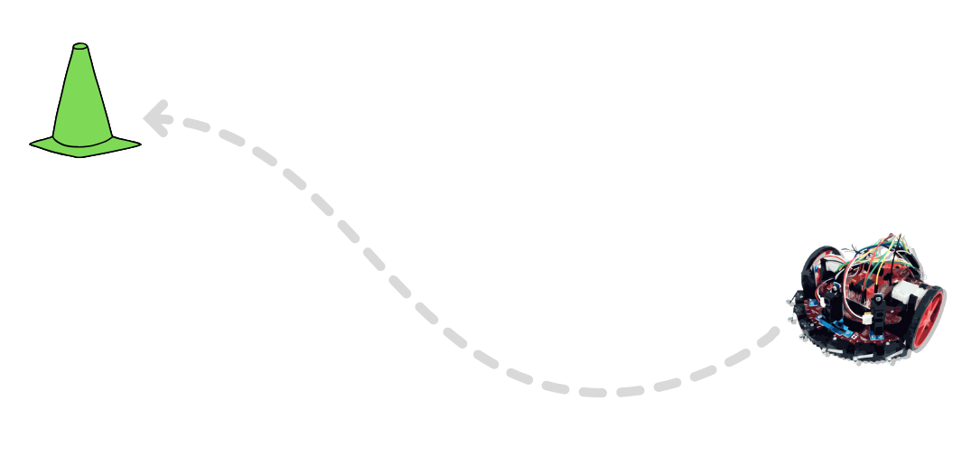
Framework Overview
System Workflow Diagram

Slide 9
NOW LET’S GO IN DEPTH

Slide 10
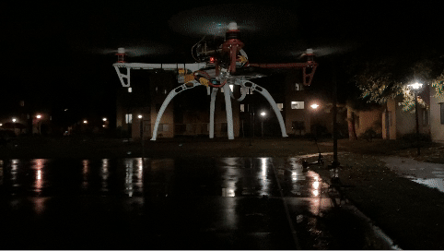
Aerial Platform
Drone Flight Test

Slide 11
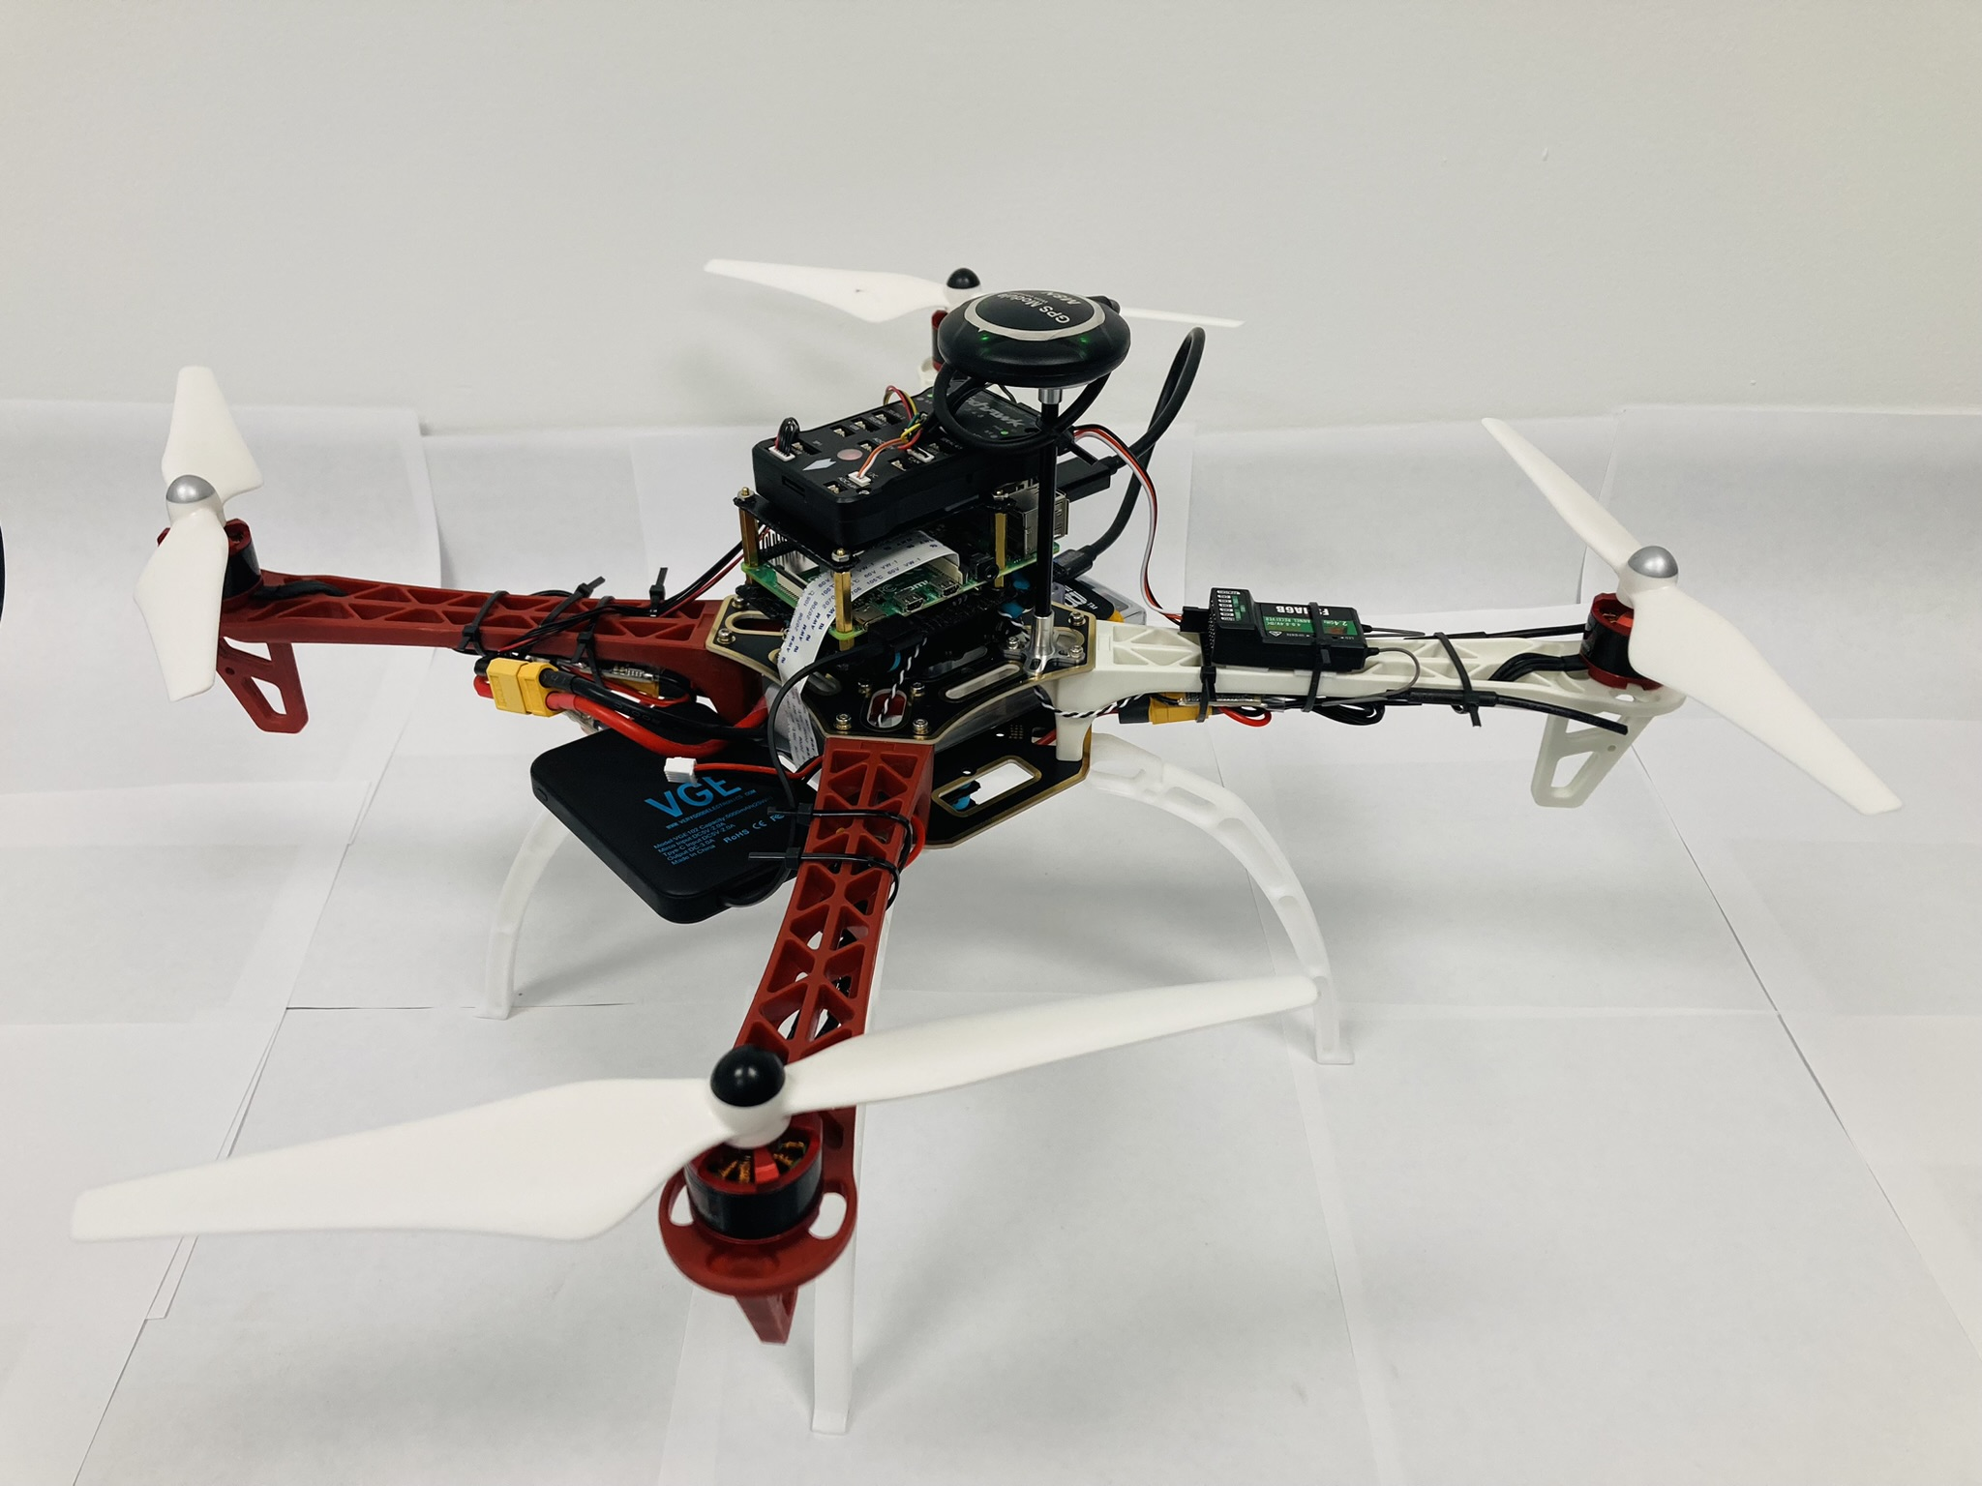
Aerial Platform
Hardware:
F450 Frame
Raspberry Pi 4
GPS, buzzer, camera, RC receiver
Pixhawk 1 (clone)
TPU (Google Coral)
Batteries
Full Drone Build

Slide 12
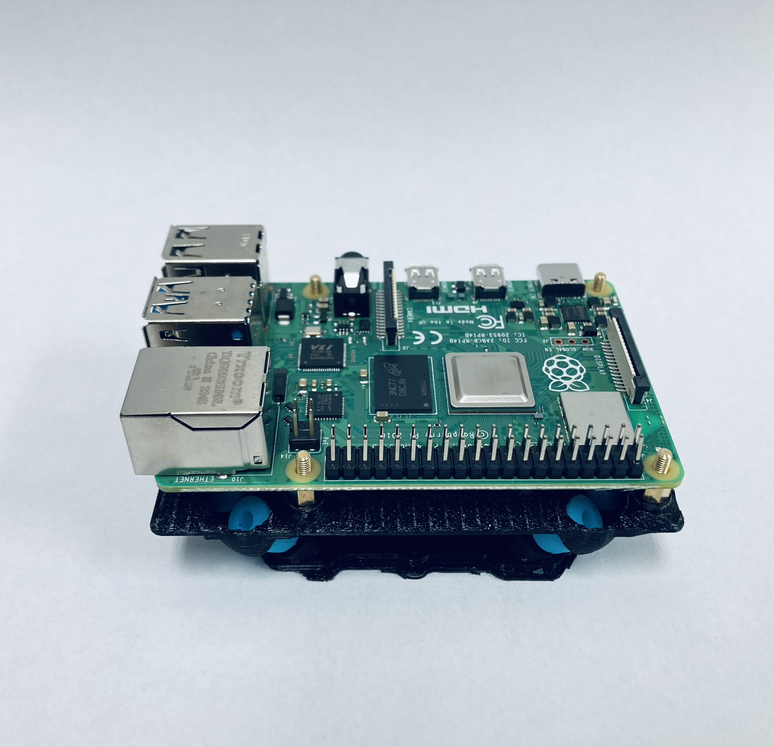
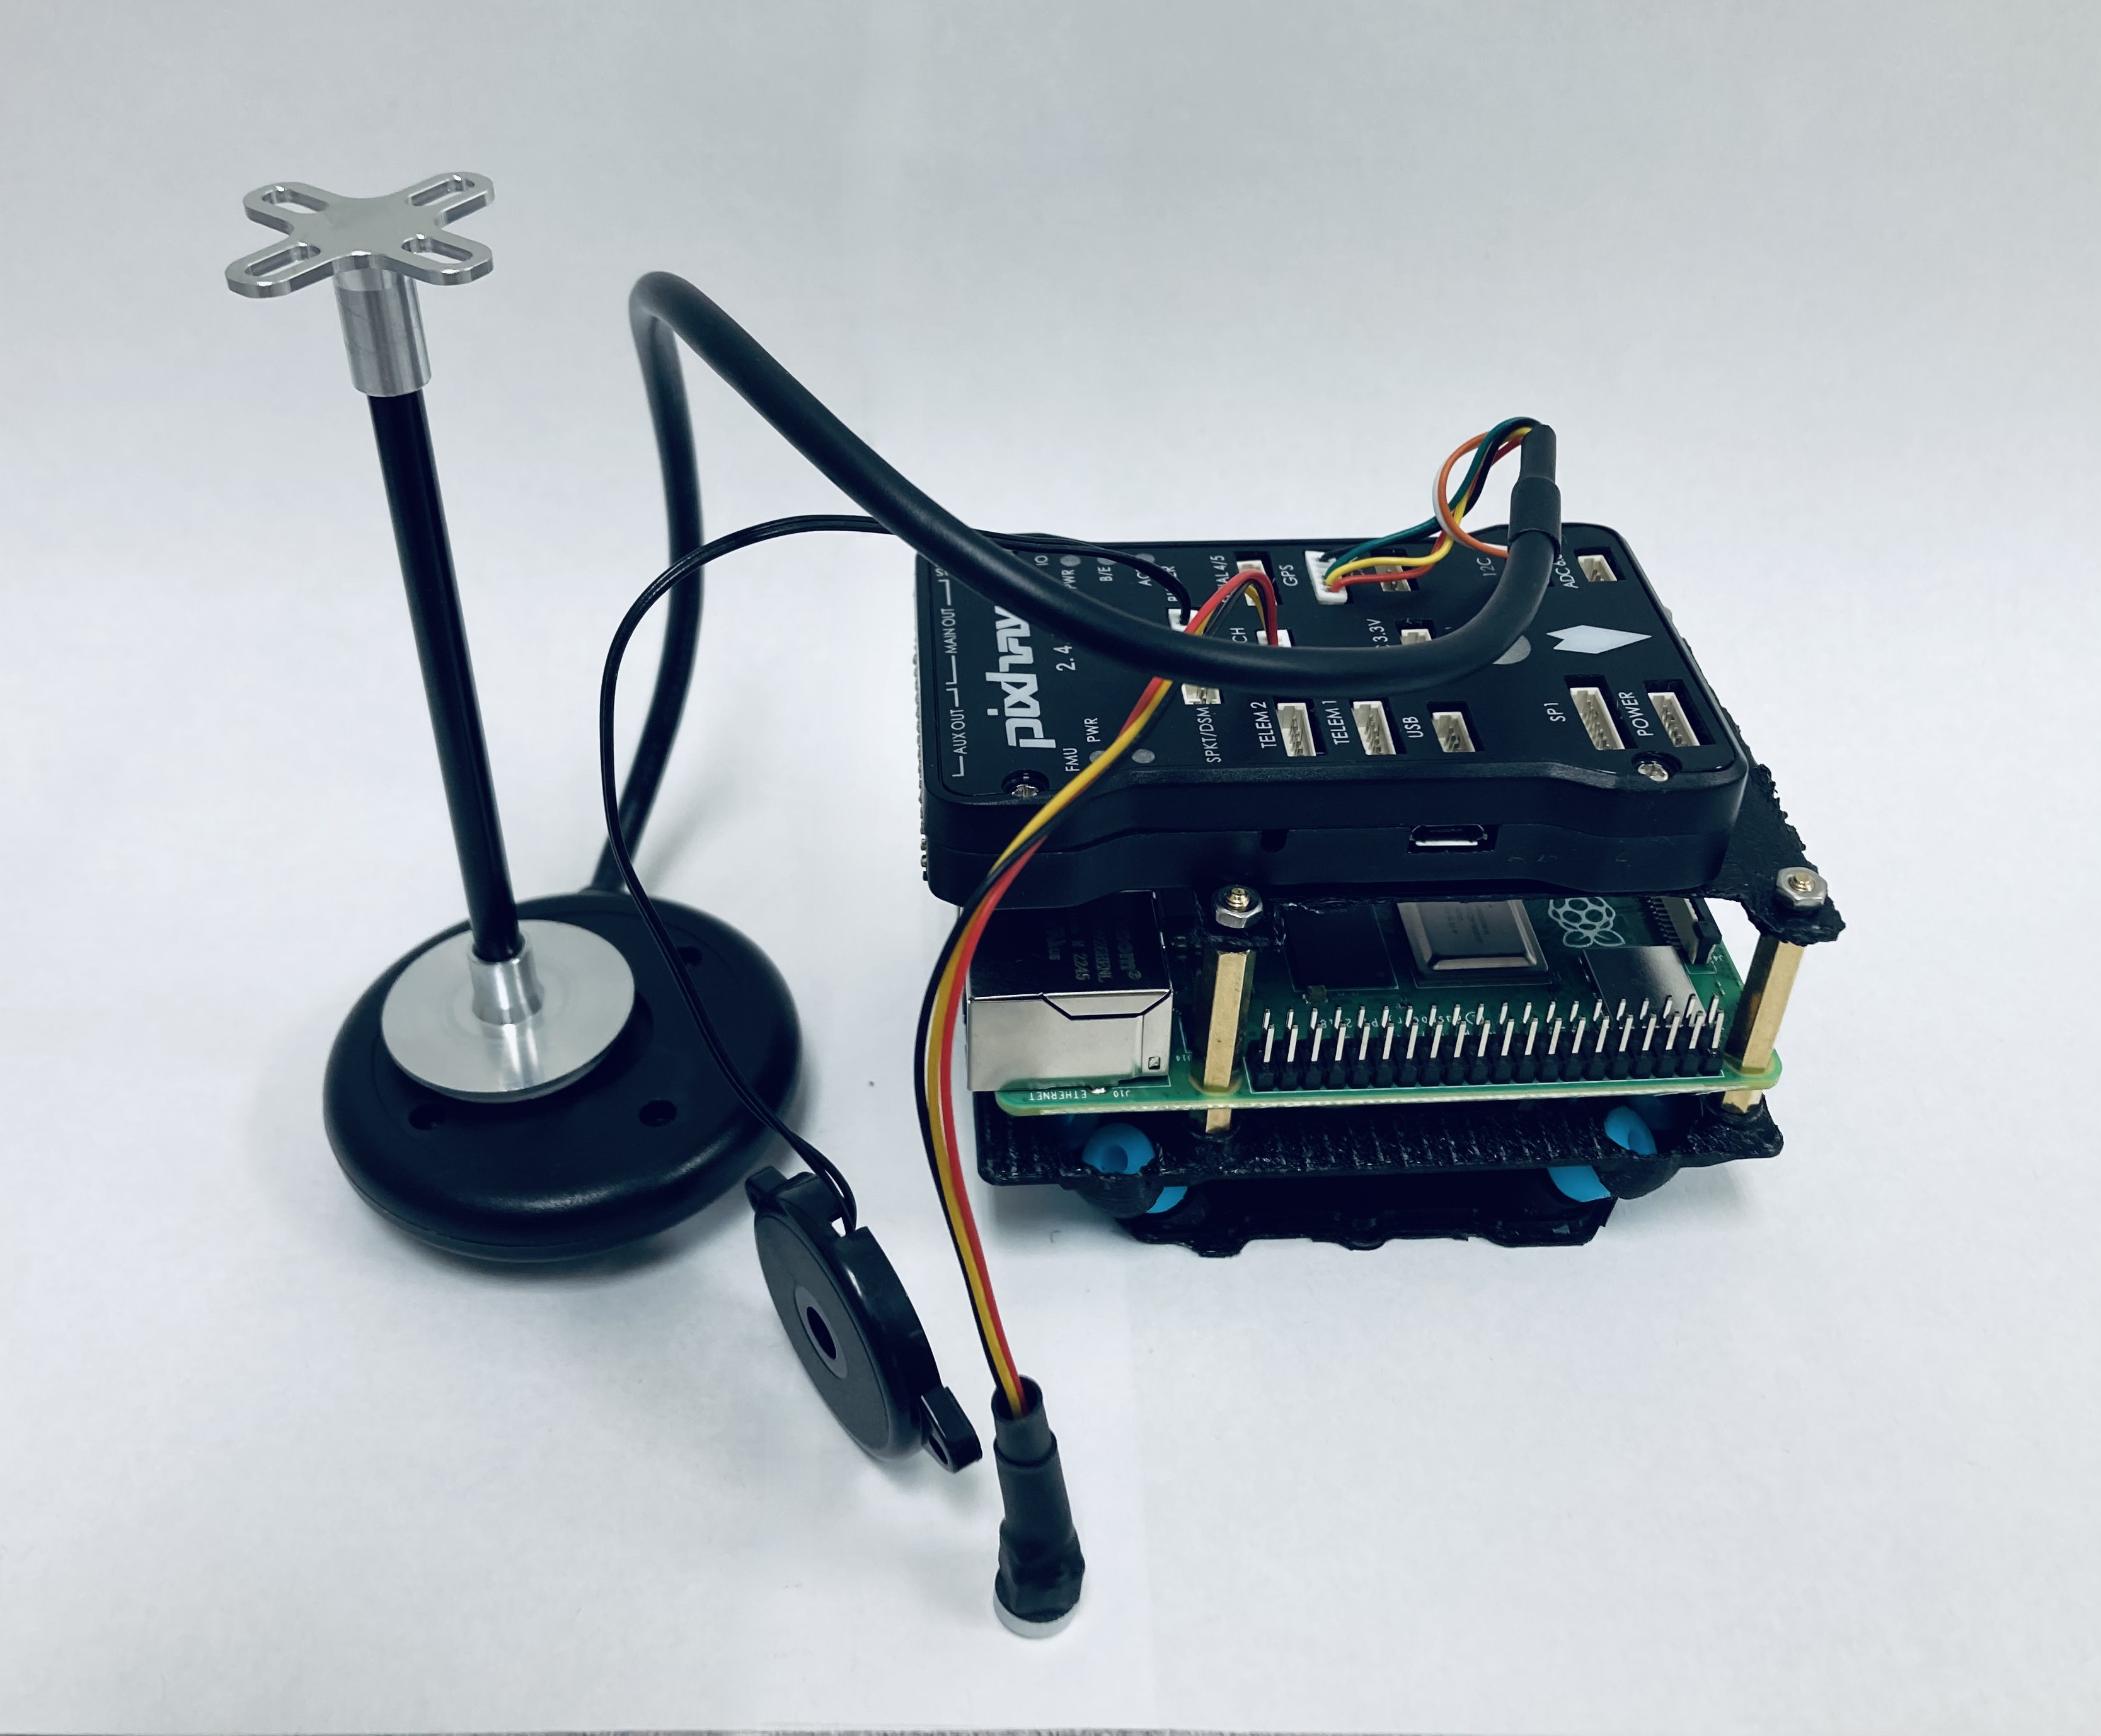
Aerial Platform
Platform Assembly
Raspberry Pi Mount
Pixhawk Mount

Slide 13
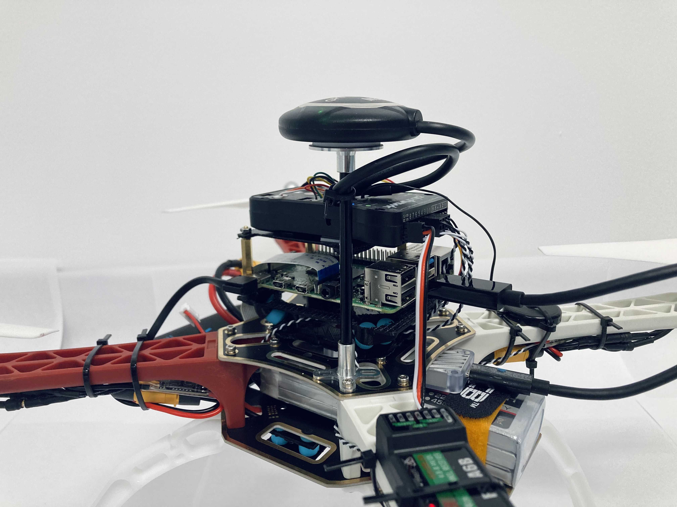
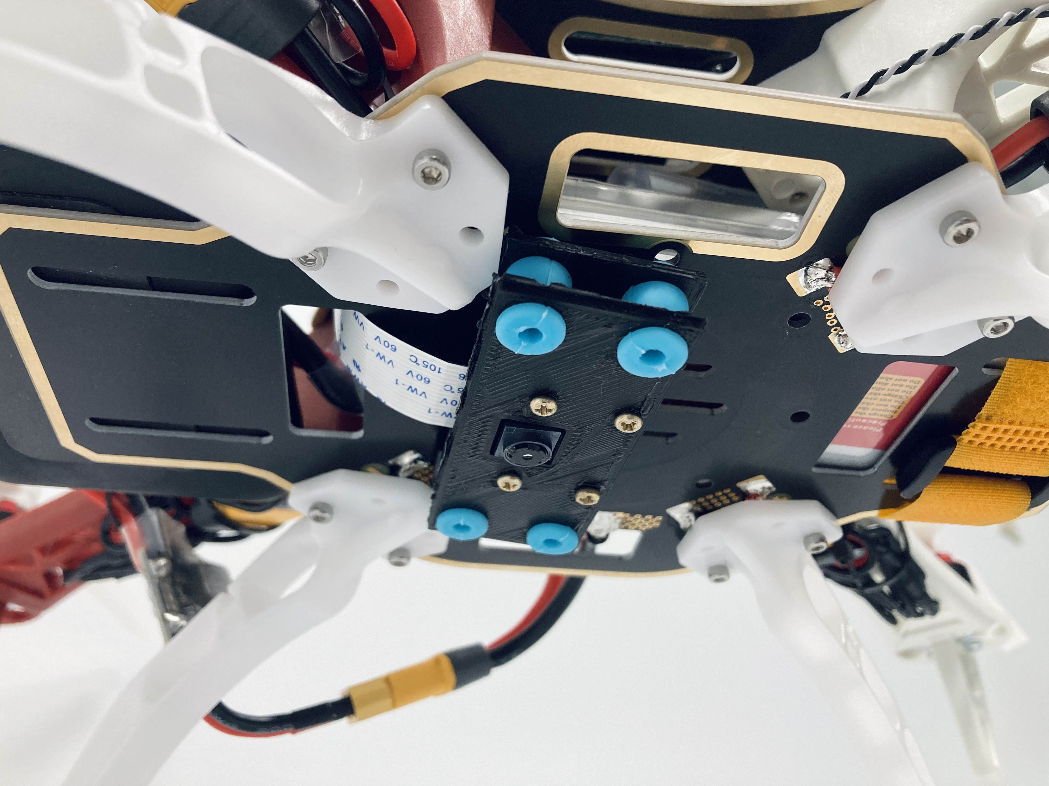
Aerial Platform
Platform Assembly
Drone Core View
Drone Bottom View (Camera)

Slide 14
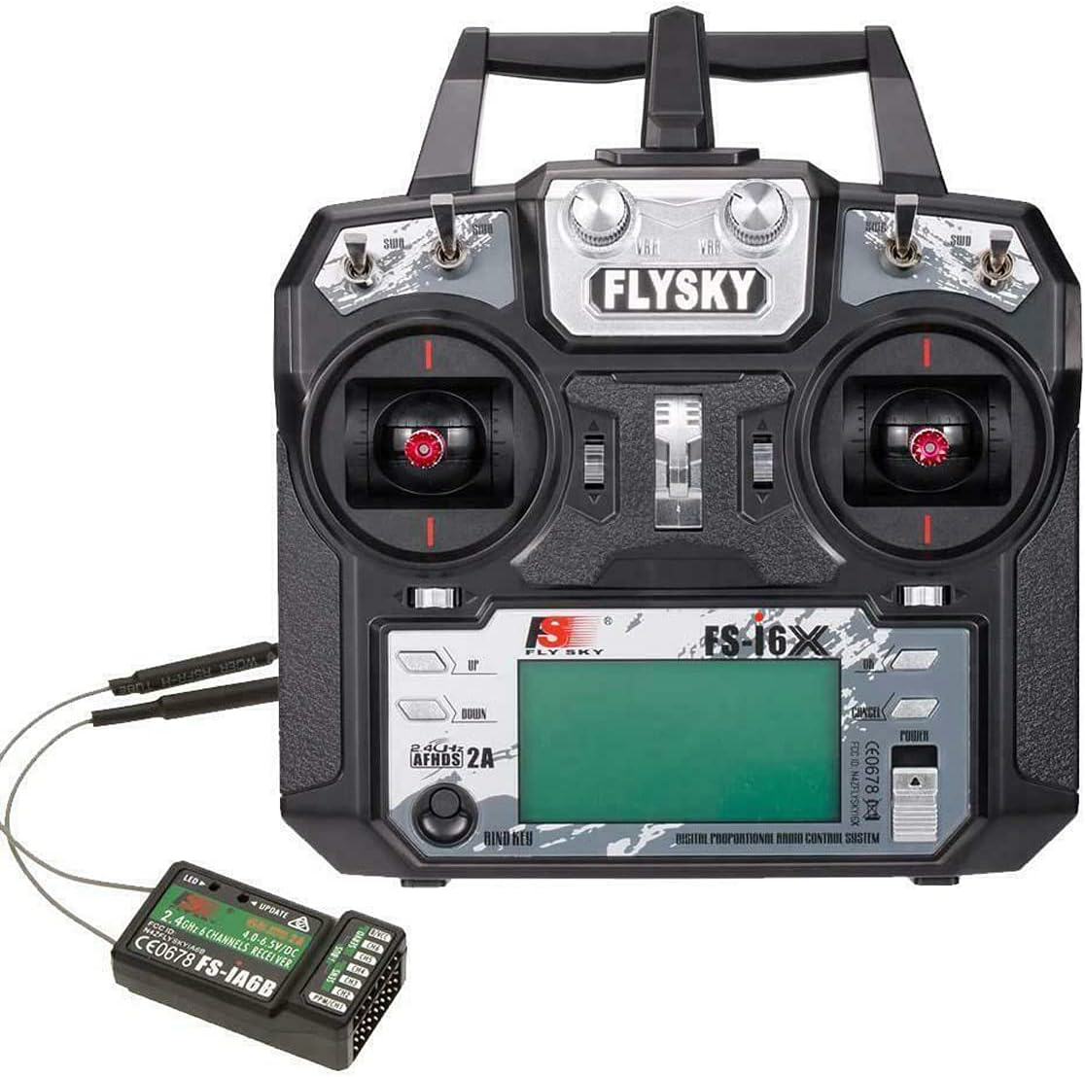
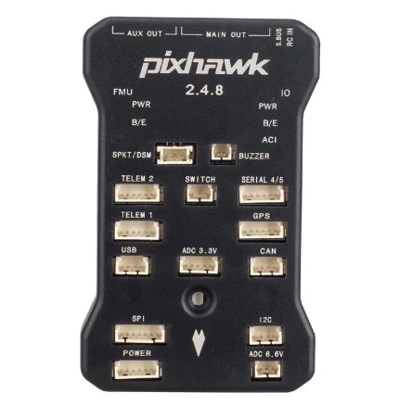
Aerial Platform
How is it being flown?
Transmitter Calibration
Receiver Binding
Flight Modes
Stabilize
Altitude hold
Loiter (GPS)
Pixhawk
FlySky FS-i6X Transmitter
iA6B Receiver

Slide 15
Aerial Platform
Software:
Calibration in Mission Planner
Model Training
SSD MobileNet V2 FPNLite 320x320 model
Coral Integration
Configuring Ubuntu for SPP 1.2 Bluetooth

Slide 16
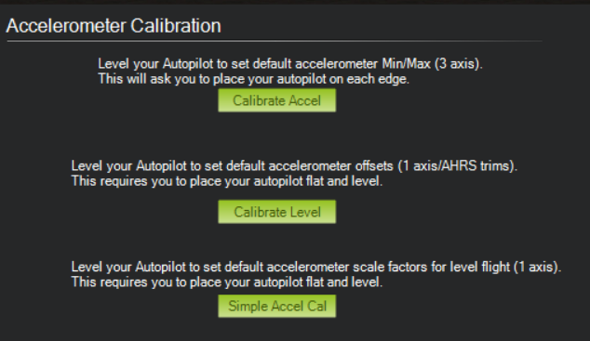
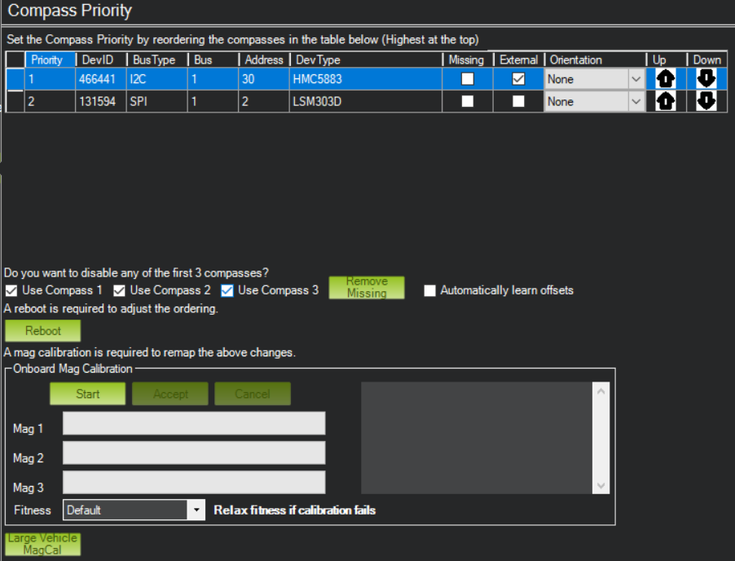
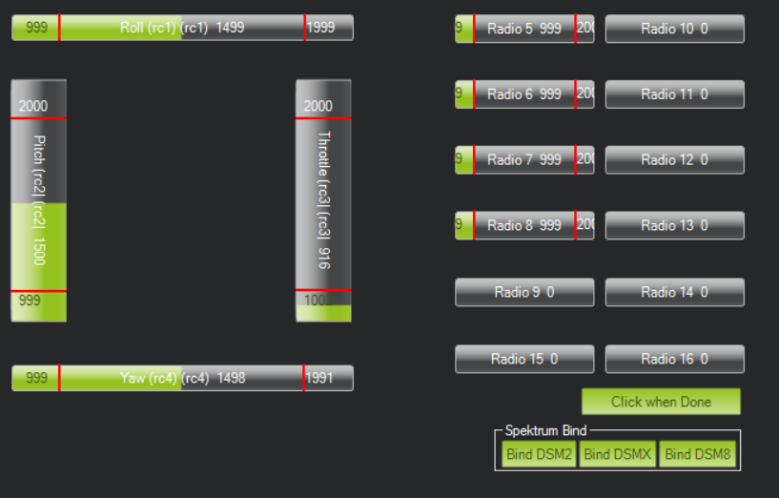
Aerial Platform
Calibration
Accelerometer Calibration
Compass Calibration
Radio Calibration

Slide 17
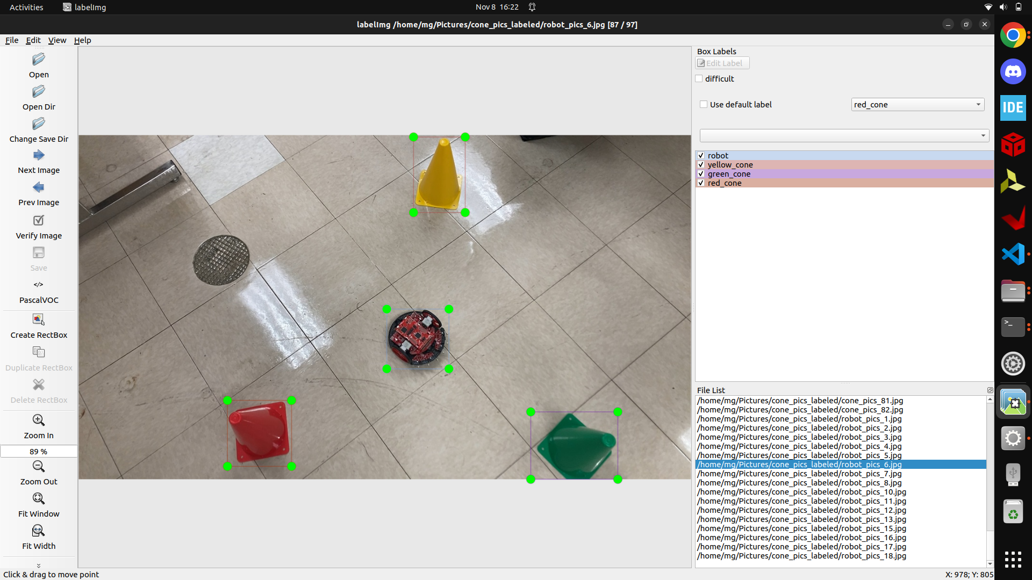
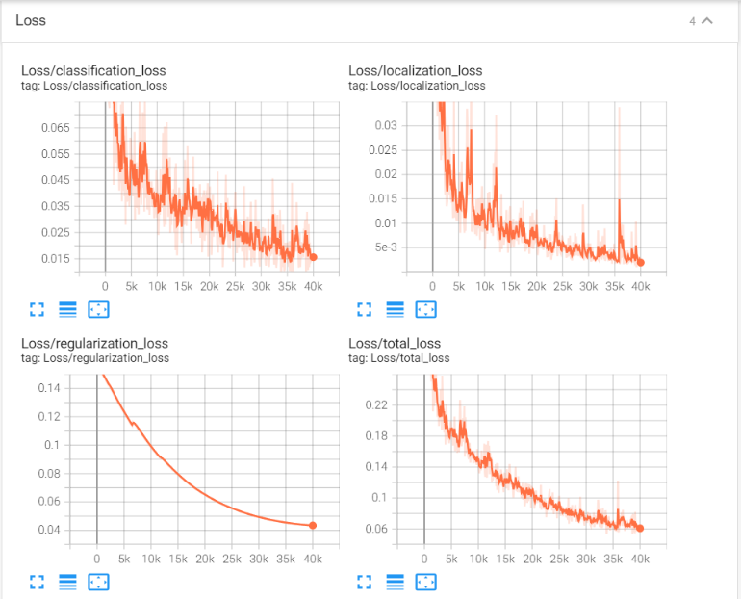
Aerial Platform
Model Training:
Labeling Database Images
Training Loss Function Monitor

Slide 18
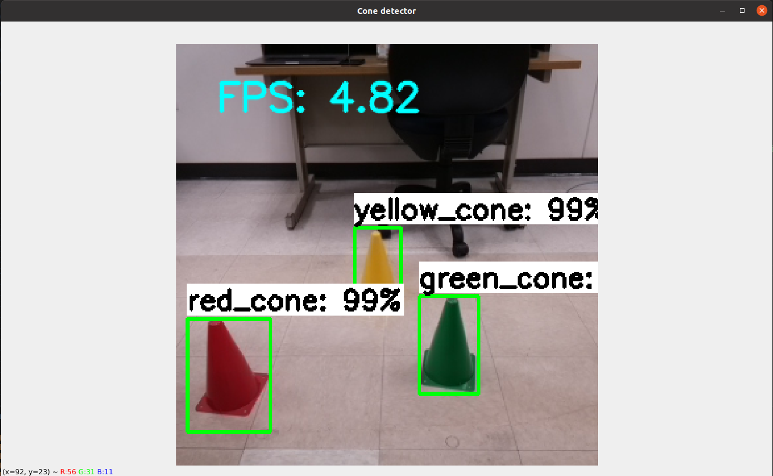
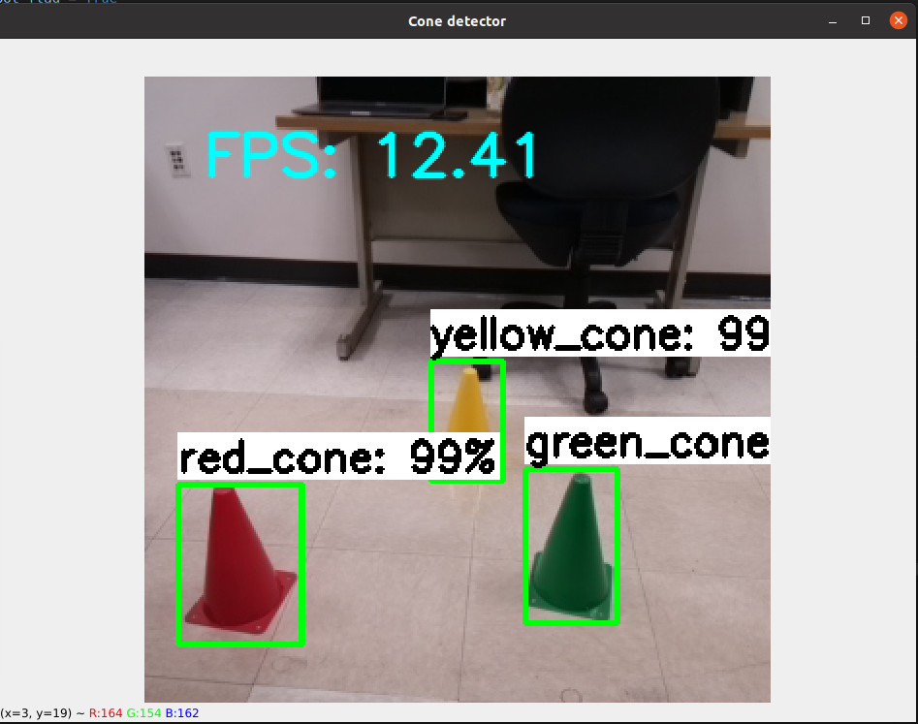
Aerial Platform
Model Test (Coral TPU Integration):
Model Test (No TPU)
Model Test (Coral TPU)

Slide 19
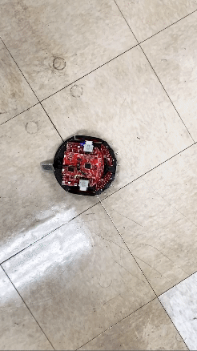
Ground Platform
Robot Drive Test (Bluetooth)

Slide 20
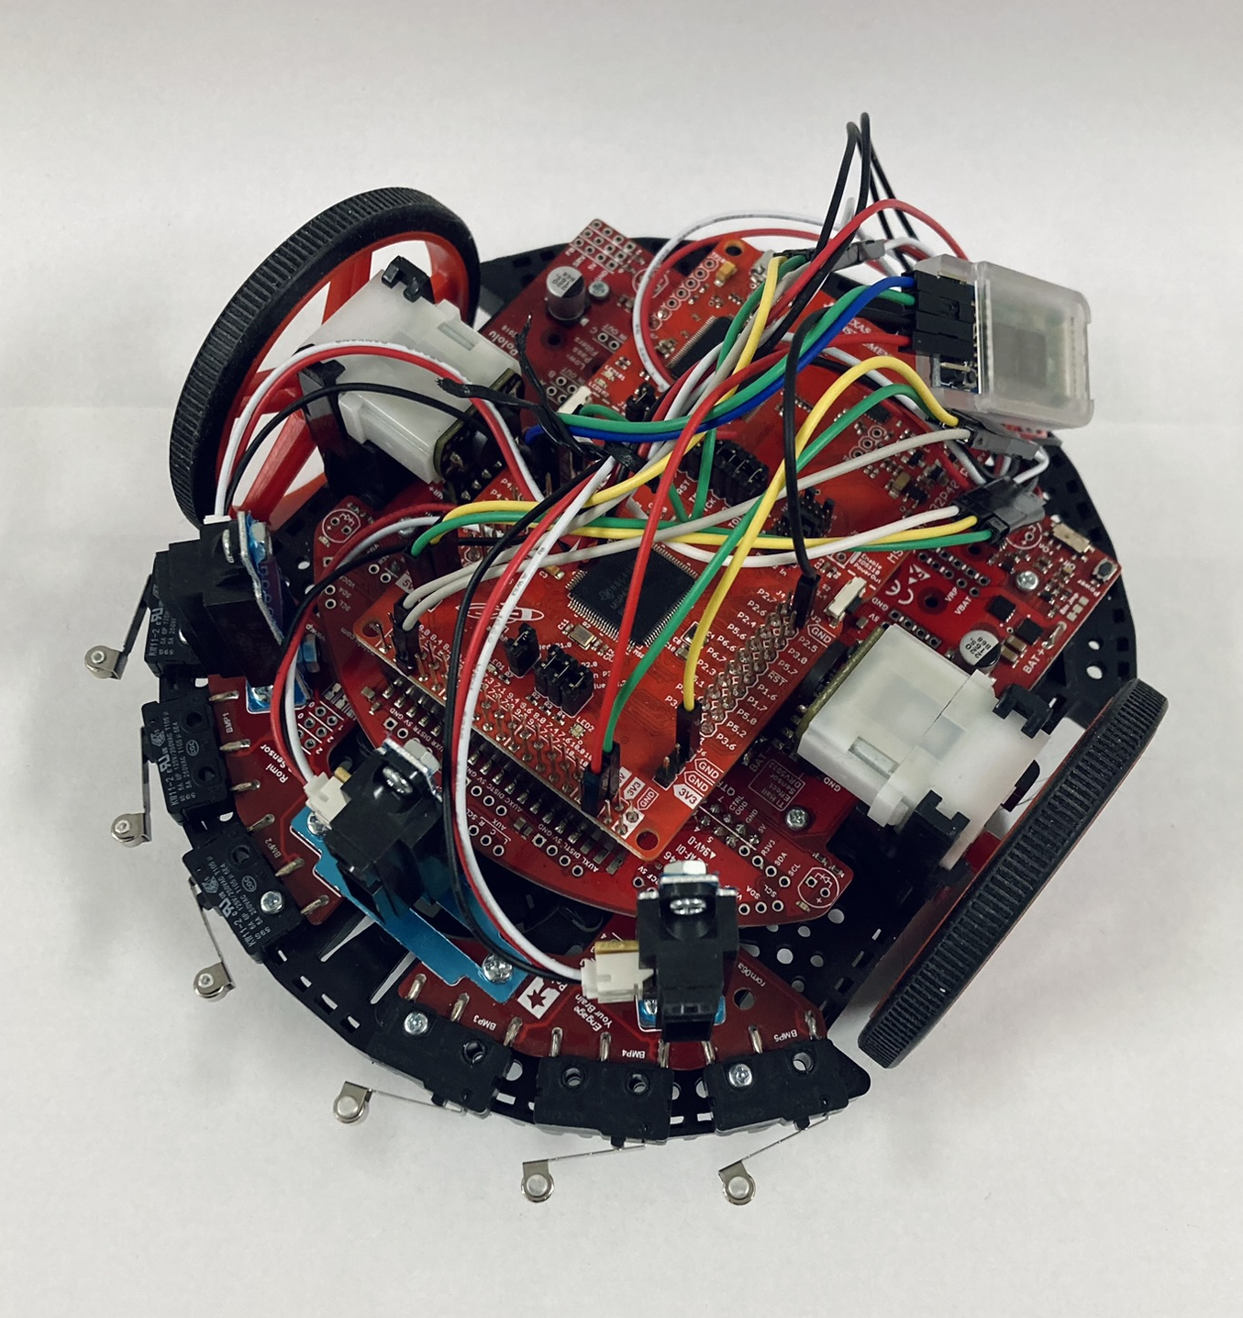
Ground Platform
Hardware:
MSP432
16-bit timer (TimerA)
Successive Approximation Register (SAR) ADC
Enhanced Universal Serial Communication Interface (eUSCI)
Chassis
6 Ni-MH batteries (1.2V)
Brushed DC Motors
3 Analog Distance Sensors
HC-05 Bluetooth Module
Full Robot Build

Slide 21
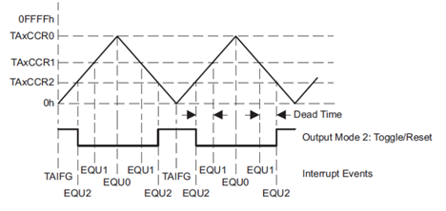
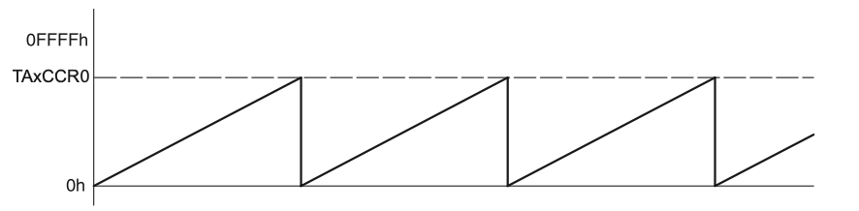
Ground Platform
Timer A:
Timer A0
Produces PWM for TI DRV8838 H-bridge motor driver
Up/ Down mode
PWM frequency: 50 Hz
Timer A1
Sample analog distance sensors
Up mode
Interrupt every 0.5 ms
Timer A0
Timer A1

Slide 22
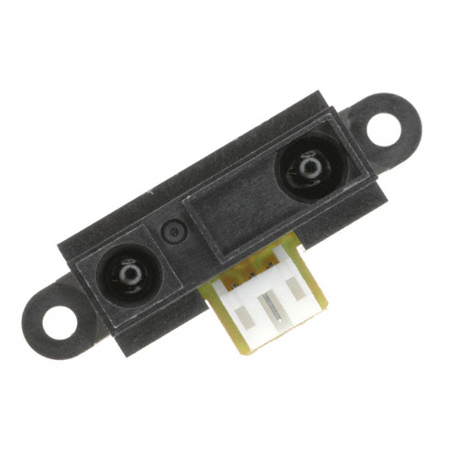
Ground Platform
Analog IR Distance Sensor
Detection range: 10 cm – 80 cm
SAR ADC:
V_{REF} = 3V
A_{VCC} = 3V, A_{VSS} = 0V
Resolution: 14 bits
Conversation Time: 16 clock cycles
Channels: A14, A16, A17
Analog IR Distance Sensor:
GP2Y0A21YK0F

Slide 23
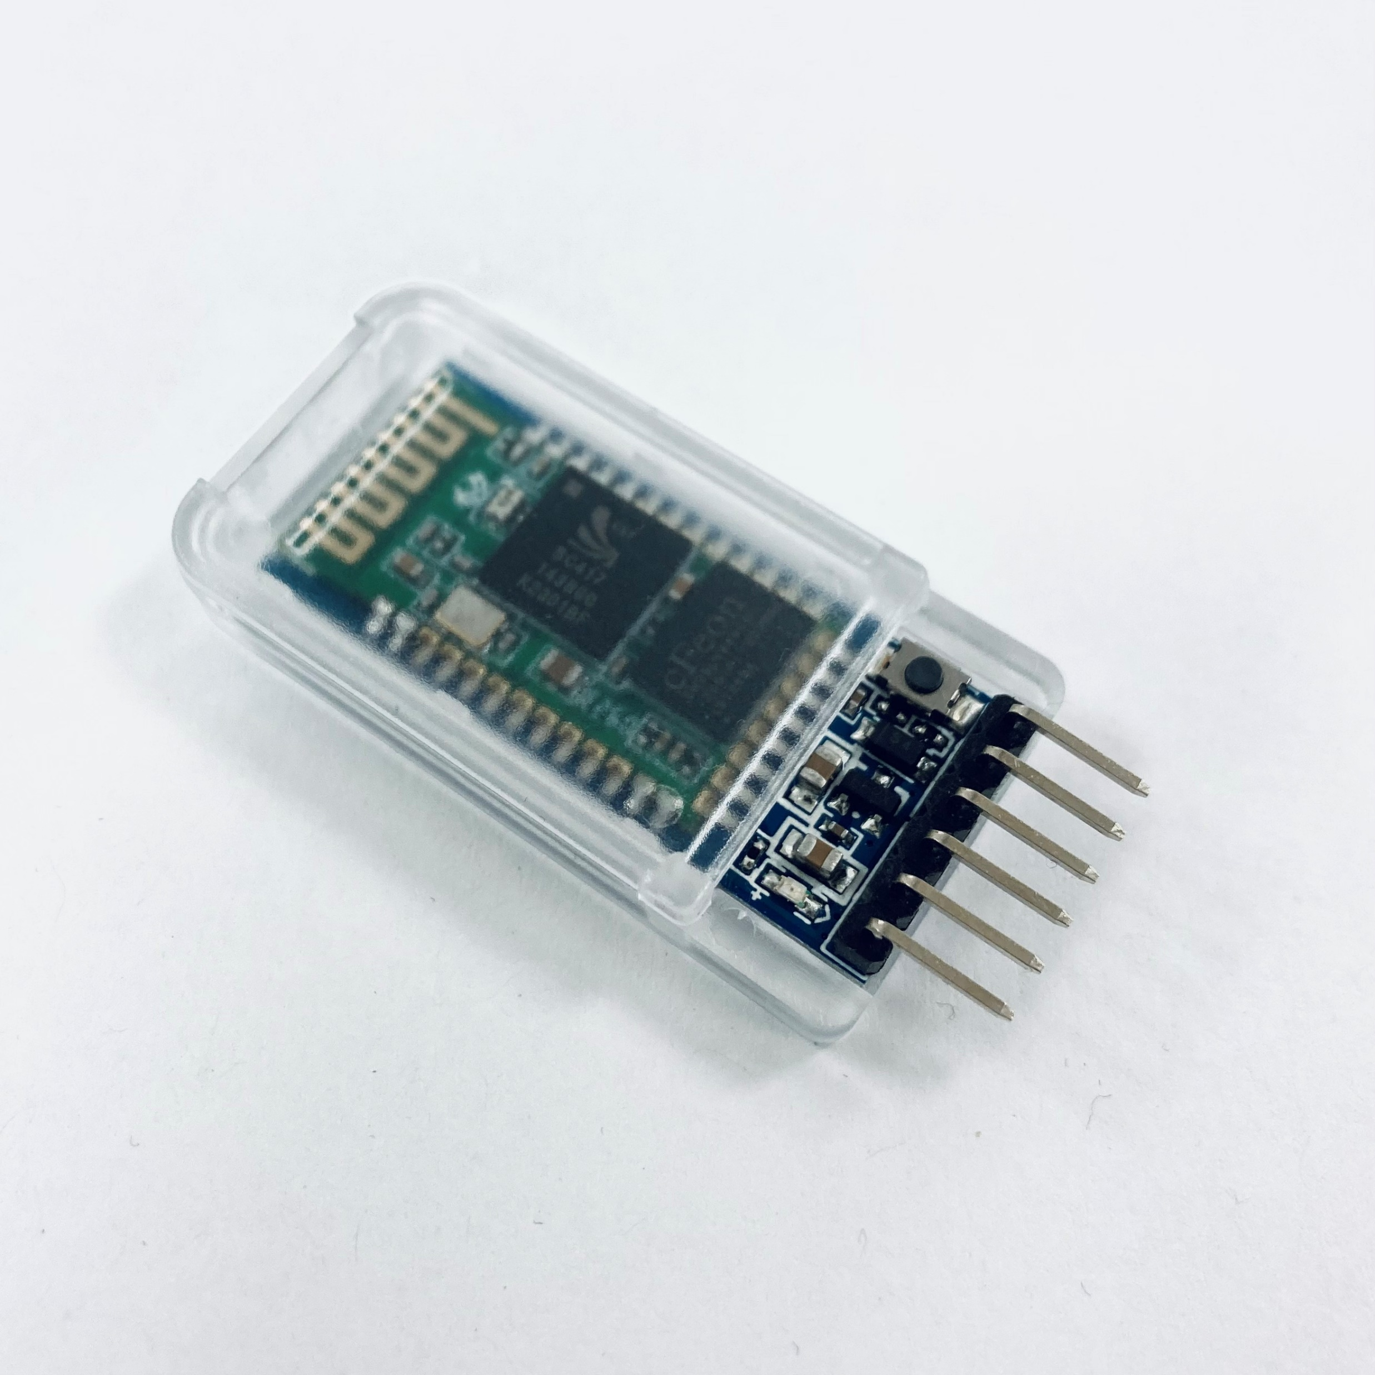
Ground Platform
HC-05 Bluetooth Module:
Virtual UART
Calibration
Data size: 8-bits
Stop bit: 1-bit
Baud rate: 115200
LSB first
HC-05 Module

Slide 24
Ground Platform
Software:
Low Level Drivers
UART
ADC
TimerA
GPIO
Main Program (State Machine):
Idle state always listening
Change state based on the received ASCII character
Robot and red cone task
Robot and yellow cone task
Robot and green cone task
while true:
listen_for_command()
if RED_COMMAND:
red_task()
else if YELLOW_COMMAND:
yellow_task()
else if GREEN_COMMAND:
green_task()
Super Loop Pseudo Code

Slide 25
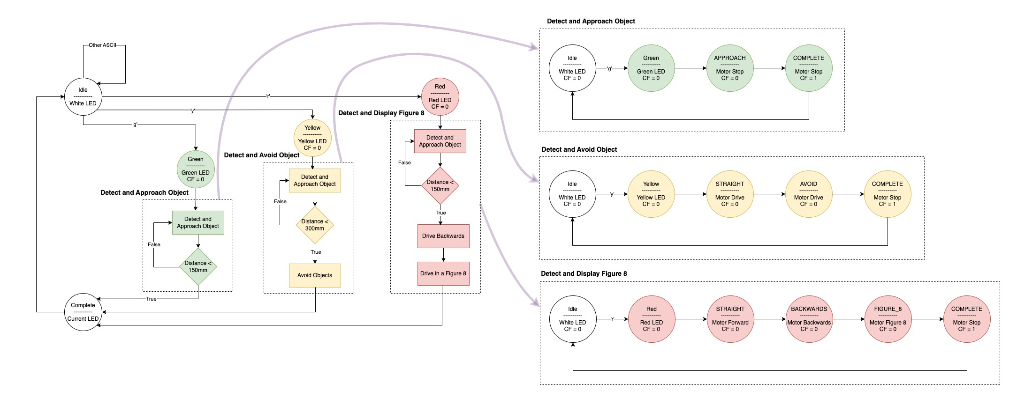
Ground Platform
Robot Algorithm Flowchart

Slide 26
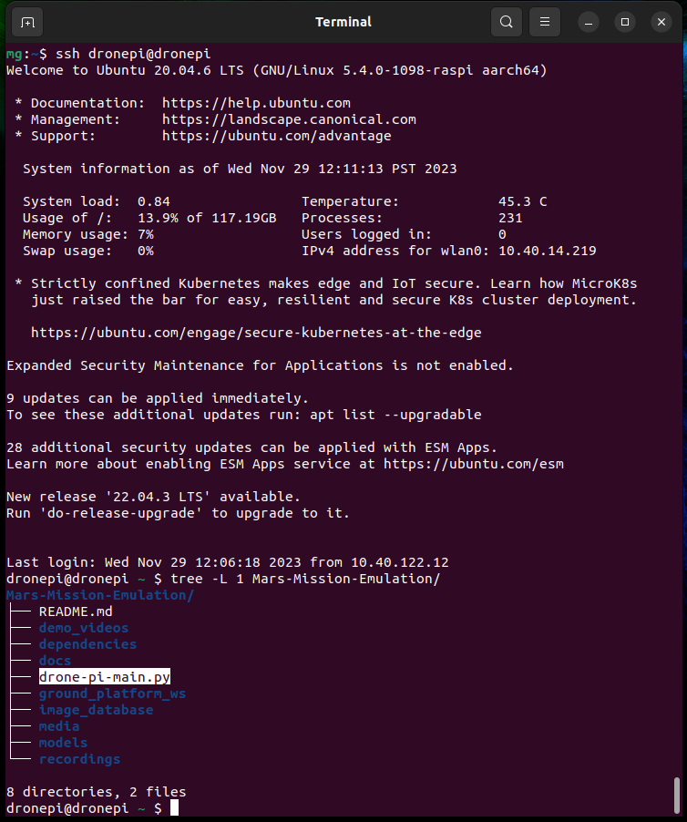
Deployment
SSH
Run Python Script
Compile Flight Images
Remote Access of Raspberry Pi
Flight Recordings
Workspace File Structure

Slide 27
Future Plans
Hardware:
Update Flight Controller
Add More Sensors on Both Platforms
Run Advanced Power Analysis
Add Raspberry Pi to the Robot
Software:
Add Autopilot Feature
Asses the Reliance on Python < 3.10
Improve the AI model
Implement Depth Maps
Integrate F’ (Fprime), ROS

Slide 28
References
[1] “ardupilot_wiki/common/source/docs/common-pixhawk-overview.rst at master · ArduPilot/ardupilot_wiki,” GitHub, Jul. 2023. https://github.com/ArduPilot/ardupilot_wiki/blob/master/common/source/docs/common-pixhawk-overview.rst (accessed Nov. 13, 2023).
[2] Evan, “Google Colaboratory,” colab.research.google.com, Jan. 2023. https://colab.research.google.com/github/EdjeElectronics/TensorFlow-Lite-Object-Detection-on-Android-and-Raspberry-Pi/blob/master/Train_TFLite2_Object_Detction_Model.ipynb#scrollTo=TI9iCCxoNlAL (accessed Nov. 14, 2023).
[3] “Get started with the USB Accelerator,” Coral, Dec. 2020. https://coral.ai/docs/accelerator/get-started
[4] “GP2Y0A21YK0F.” https://global.sharp/products/device/lineup/data/pdf/datasheet/gp2y0a21yk_e.pdf (accessed Nov. 14, 2023).
[5] “HAWK’S WORK - YouTube,” www.youtube.com, Sep. 2022. https://www.youtube.com/@hawkswork1911 (accessed Nov. 13, 2023).
[6] “HC-05 Bluetooth module,” ITead Studio, 2010. Available: https://components101.com/sites/default/files/component_datasheet/HC-05%20Datasheet.pdf
[7] J. W. Valvano, Embedded systems: introduction to robotics. 2020.
[8] “MSP432P401R, MSP432P401M MSP432P401R, MSP432P401M Mixed-Signal Microcontrollers 1 Device Overview,” Texas Instruments, 2015. Available: https://www.ti.com/lit/ds/slas826e/slas826e.pdf
[9] “MSP432E4 SimpleLinkTM Microcontrollers Technical Reference Manual,” Texas Instruments, 2017. Accessed: Nov. 14, 2023. [Online]. Available: https://www.ti.com/lit/ug/slau723a/slau723a.pdf
[10] “Multi-Camera CamArray - Arducam Wiki,” docs.arducam.com. https://docs.arducam.com/Raspberry-Pi-Camera/Multi-Camera-CamArray/Multi-Camera-CamArray/#arducam-multi-camera-adapter-board (accessed Nov. 14, 2023).
[11] S. Monk, Raspberry Pi Cookbook, 1st ed. “O’Reilly Media, Inc.,” 2016.
[12] “tensorflow/models,” GitHub, Nov. 2021. https://github.com/tensorflow/models/blob/master/research/object_detection/g3doc/tf2_detection_zoo.md
[13] “Texas Instruments Robotics System Learning Kit User guide Robot Systems Learning Kit (TI-RSLK) User Guide 2 Texas Instruments Robotics System Learning Kit: The Solderless Maze Edition SEKP166,” Texas Instruments. Accessed: Nov. 14, 2023. [Online]. Available: https://www.ti.com/lit/ml/sekp166/sekp166.pdf?ts=1699871498689&ref_url=https%253A%252F%252Fwww.google.com%252F
[14] “The Discerning User’s Guide to F´,” F´, 2017. https://nasa.github.io/fprime/UsersGuide/guide.html (accessed Nov. 14, 2023).

